Slide 1
















Module 3: Digital Systems

Slide 2



7. Computer organization & Memory types

Slide 3
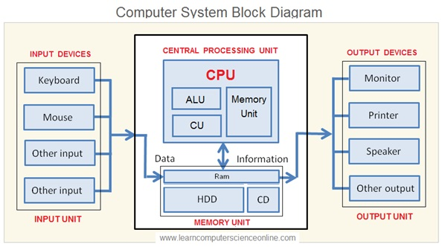









Computer Organization
A stored program computer has the following basic units:
Processor - center for manipulation and control
Memory - storage for instructions and data for currently executing programs
I/O system - controller which communicate with "external" devices: secondary memory, display devices, networks
Data-path & control - collection of parallel wires, transmits data, instructions, or control signal
Computer organization defines the ways in which these components are interconnected and controlled.

Slide 4





Arithmetic and logic Unit (ALU)
ALU is responsible to perform the operation in the computer.
ALU is having collection of two types of operations:
Arithmetic operations
Logical operations
Consider an ALU having 4 arithmetic operations and 4 logical operation.
Consider an ALU is having four arithmetic operations. Addition, subtraction, multiplication and division. Also consider that the ALU is having four logical operations: OR, AND, NOT & EX-OR.

Slide 5
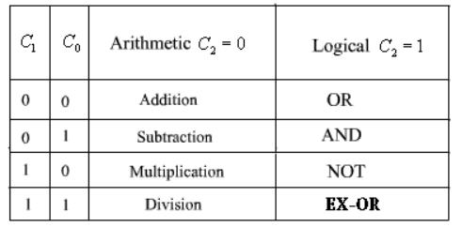























Arithmetic and logic Unit (ALU)
To identify any one of these four logical operations or four arithmetic operations, two control lines are needed.
Also to identify the any one of these two groups- arithmetic or logical, another control line is needed.
So, with the help of three control lines, any one of these eight operations can be identified.
Control line C2 is used to identify the group: logical or arithmetic, i.e.,: arithmetic operation : logical operation.
Control lines C0 and C1 are used to identify any one of the four operations in a group. One possible combination is given here.

Slide 6
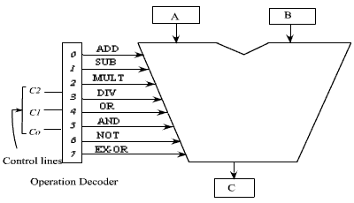





Block Diagram of the ALU
A decode is used to decode the instruction.
The ALU has got two input registers named as A and B and one output storage register, named as C.
The input data are stored in A and B, and according to the operation specified in the control lines, the ALU perform the operation and put the result in register C.

Slide 7
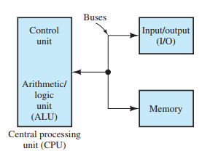






Control unit
The control unit supervises the operation of the computer, such as determining the location of the next instruction to be retrieved from memory and setting up the ALU to carry out operations on data.

Slide 8

Programs
Programs are sequences of instructions stored in memory.
Typically, the controller fetches (i.e., retrieves) an instruction, determines what operation is called for by the instruction, fetches data from memory as required, causes the ALU to perform the operation, and writes results back to memory.
Then, the next instruction is fetched, and the process is repeated.

Slide 9
Buses
The various elements of a computer are connected by buses, which are sets of conductors that transfer multiple bits at a time.
For example, the data bus transfers data (and instructions) between the CPU and memory (or I/O devices).
The control buses are used to direct the operations of the computer.
Buses can be bidirectional. In other words, they can transfer data in either direction.

Slide 10
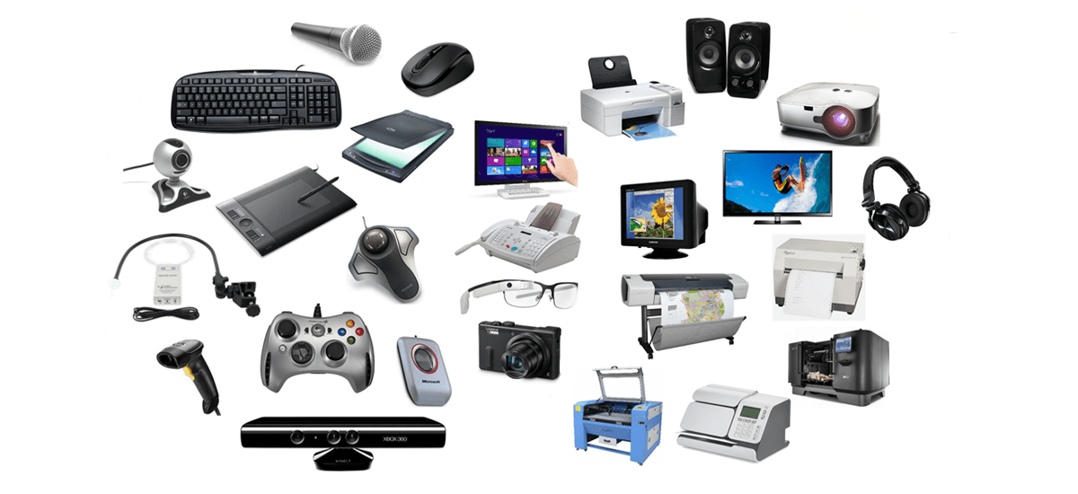





Input - Output
Some examples of I/O devices are keyboards, display devices, and printers.
Both
Output Devices
Input Devices

Slide 11



Memory types
Several types of memory are used in computers:
Read-and-write memory (RAM),
Read-only memory (ROM), and
Mass storage.

Slide 12












RAM
Read-and-write memory (RAM) is used for storing data, instructions, and results during execution of a program.
Usually, the information that is stored in RAM is lost when power is removed. Thus, we say that RAM is volatile.
Originally, the acronym RAM meant random access memory, but the term has changed its meaning over time.
There are two types of RAM in common use.
Static RAM and
Dynamic RAM

Slide 13
Static and dynamic ram
In static RAM, the storage cells are SR flip-flops that can store data indefinitely, provided that power is applied continuously.
In dynamic RAM, information is stored in each cell as charge (or lack of charge) on a capacitor.
Because the charge leaks off the capacitors, it is necessary to refresh the information periodically.
This makes the use of dynamic RAM more complex than the use of static RAM.
The advantage of dynamic RAM is that the basic storage cell is smaller, so that chips with larger capacities are available.
A relatively small amount of RAM is needed in most control applications, and it is simpler to use static RAM.

Slide 14












ROM
In normal operation, read-only memory (ROM) can be read, but not written to.
The chief advantages of ROM are that data can be read quickly in random order and that information is not lost when power is turned off.
Thus, we say that ROM is nonvolatile (i.e., permanent).
ROM is useful for storing programs such as the boot program, which is executed automatically when power is applied to a computer.
Several types of ROM exist.
mask-programmable ROM,
programmable read-only memory (PROM)
Erasable PROM (EPROM)
Electrically erasable PROMs (EEPROMs)
Flash memory

Slide 15







ROM
In mask-programmable ROM, the data are written when the chip is manufactured.
In programmable read-only memory (PROM), data can be written by special circuits that blow tiny fuses or leave them unblown, depending on whether the data bits are zeros or ones.
Erasable PROM (EPROM) is another type that can be erased by exposure to ultraviolet light (through a window in the chip package) and rewritten by using special circuits.
Electrically erasable PROMs (EEPROMs) can be erased by applying proper voltages to the chip.
Flash memory is a nonvolatile technology in which data can be erased and rewritten relatively quickly in blocks of locations, ranging in size from 512 bytes up to 512 Kbytes.

Slide 16







Mass Storage
Mass-storage units include hard disks and flash memory, both of which are read/write memory.
Another type is CD-ROM (Compact Disk-Read Only Memory) and DVD-ROM (Digital Versatile Disc-Read Only Memory) disks, which are used for storing large amounts of data.
Mass storage is the least expensive type of memory per unit of capacity

Slide 17

MCQ 1
The instruction used in a program for executing them is stored in the __________
a) CPU
b) Control Unit
c) Memory
d) Microprocessor
C

Slide 18
MCQ 2
CD-ROM refers to __________
a) Floppy disk
b) Compact Disk-Read Only Memory
c) Compressed Disk-Read Only Memory
d) Compressed Disk- Random Access Memory
B

Slide 19
MCQ 3
A ROM is defined as __________
a) Read Out Memory
b) Read Once Memory
c) Read Only Memory
d) Read One Memory
C

Slide 20
MCQ 4
The full form of PROM is __________
a) Previous Read Only Memory
b) Programmable Read Out Memory
c) Programmable Read Only Memory
d) Previous Read Out Memory
C

Slide 21
MCQ 5
The full form of EPROM is __________
a) Easy Programmable Read Only Memory
b) Erasable Programmable Read Only Memory
c) Eradicate Programmable Read Only Memory
d) Easy Programmable Read Out Memory
B

Slide 22
MCQ 6
The full form of EPROM is __________
a) Easy Programmable Read Only Memory
b) Erasable Programmable Read Only Memory
c) Eradicate Programmable Read Only Memory
d) Easy Programmable Read Out Memory
B

Slide 23

MCQ 7
A memory is a collection of ____________
a) Unit cells
b) Storage cells
c) Data cells
d) Binary cells
B

Slide 24
MCQ 8
Mask programming is also known as __________
a) EPROM
b) PROM
c) Custom programming
d) Both PROM and EPROM
C

Slide 25
MCQ 9
These devices provide a means of communication between a computer and outer world.
a) I/O
b) Storage
c) Compact
d) Drivers
A

Slide 26
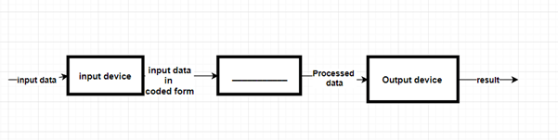

MCQ 10
Identify the blank space in the diagram.
a) Processor
b) Memory
c) CPU
d) Storage
A

Slide 27
MCQ 11
Which of the following is not a point-and-draw device?
a) Keypad
b) Trackball
c) Touch screen
d) Mouse
A

Slide 28
MCQ 12
The ALU gives the output of the operations and the output is stored in the ________
a) Memory Devices
b) Registers
c) Flags
d) Output Unit
B

Slide 29
8. counters

Slide 30
Counters
A Counter is a device which stores (and sometimes displays) the number of times a particular event or process has occurred, often in relationship to a clock signal.
Counters are used in digital electronics for counting purpose, they can count specific event happening in the circuit.
Counters are broadly divided into two categories
Asynchronous counter
Synchronous counter

Slide 31
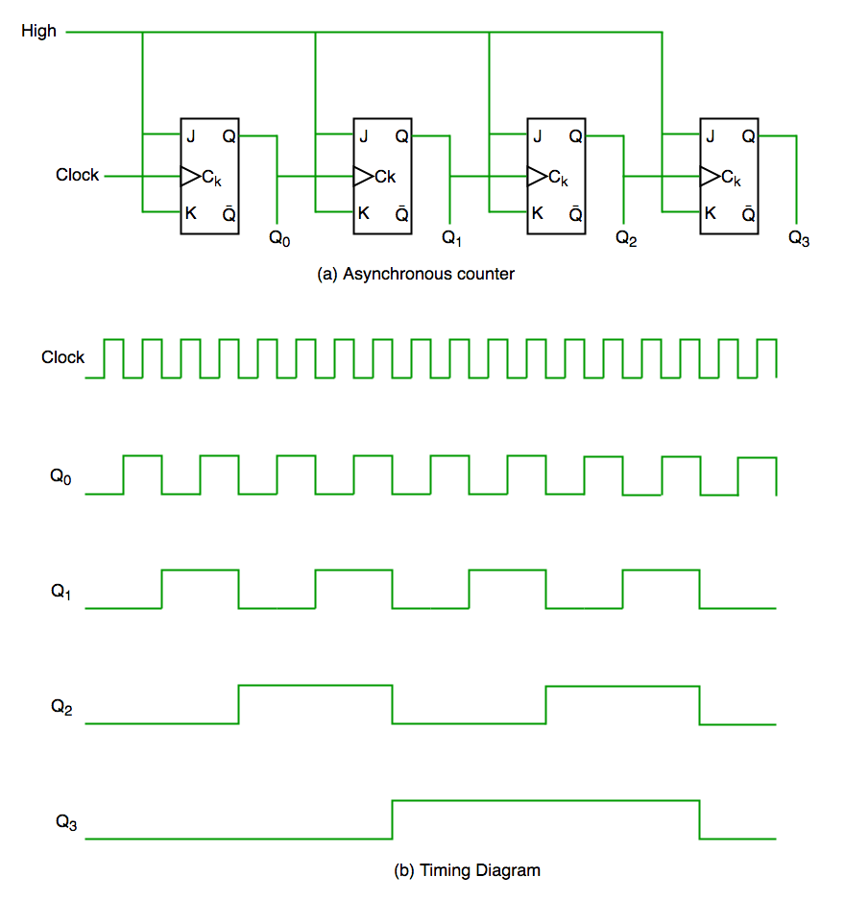
Asynchronous Counter
In asynchronous counter we don’t use universal clock, only first flip flop is driven by main clock and the clock input of rest of the following flip flop is driven by output of previous flip flops.
It is evident from timing diagram that Q0 is changing as soon as the rising edge of clock pulse is encountered, Q1 is changing when rising edge of Q0 is encountered (because Q0 is like clock pulse for second flip flop) and so on. In this way ripples are generated through Q0,Q1,Q2,Q3 hence it is also called RIPPLE counter.

Slide 32
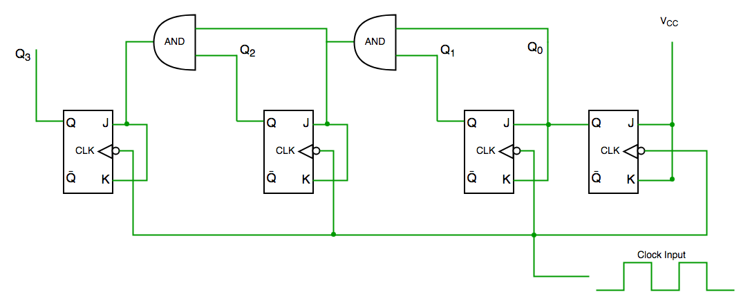
Synchronous Counter
Unlike the asynchronous counter, synchronous counter has one global clock which drives each flip flop so output changes in parallel.
The one advantage of synchronous counter over asynchronous counter is, it can operate on higher frequency than asynchronous counter as it does not have cumulative delay because of same clock is given to each flip flop.

Slide 33
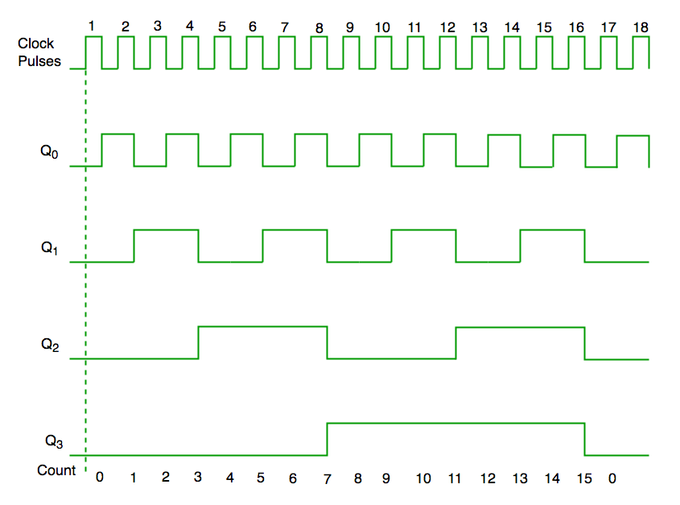
Synchronous Counter
From circuit diagram we see that Q0 bit gives response to each falling edge of clock while Q1 is dependent on Q0, Q2 is dependent on Q1 and Q0, Q3 is dependent on Q2, Q1 and Q0.

Slide 34
MCQ 1
1. In digital logic, a counter is a device which ____________
a) Counts the number of outputs
b) Stores the number of times a particular event or process has occurred
c) Stores the number of times a clock pulse rises and falls
d) Counts the number of inputs
B

Slide 35
MCQ 2
A counter circuit is usually constructed of ____________
a) A number of latches connected in cascade form
b) A number of NAND gates connected in cascade form
c) A number of flip-flops connected in cascade
d) A number of NOR gates connected in cascade form
C

Slide 36
MCQ 3
Ripple counters are also called ____________
a) SSI counters
b) Asynchronous counters
c) Synchronous counters
d) VLSI counters
B

Slide 37
MCQ 4
One of the major drawbacks to the use of asynchronous counters is that ____________
a) Low-frequency applications are limited because of internal propagation delays
b) High-frequency applications are limited because of internal propagation delays
c) Asynchronous counters do not have major drawbacks and are suitable for use in high- and low-frequency counting applications
d) Asynchronous counters do not have propagation delays, which limits their use in high-frequency applications
B

Slide 38
MCQ 5
Internal propagation delay of asynchronous counter is removed by ____________
a) Ripple counter
b) Ring counter
c) Modulus counter
d) Synchronous counter
D

